Slide 1
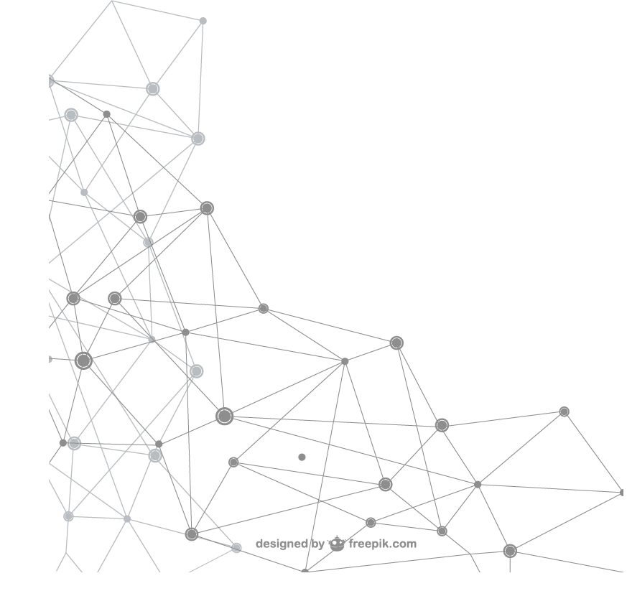

UNOPS
Putting UNOPS competency framework into action – development of a leadership mindset
Notes:
Welcome and Intro

Slide 2


ABOUT THE PROJECT:
The project 'Define our DNA' was launched with the intention to design a future oriented Competency Framework, developed by our global personnel:
Numerous focus groups and visionary interviews were conducted in offices globally covering all regions and levels.
A survey was launched thereafter to validate the first outputs resulting in a very solid framework. Overall, more than 300 colleagues have contributed to the design of our new framework, making it truly unique to UNOPS.
With a bottom up, fit for purpose and future oriented Competency Framework in place, we describe what it means to be part of UNOPS and what makes us thrive as individuals and teams, allowing us to continue to meet and exceed expectations of our partners and beneficiaries.
Notes:
The Competency Framework is in line with the new Talent Management Framework and our commitment to have the right people in the right place, making UNOPS a greater place to work
CF Framework was finalized late last year and we are going to spend this year on rolling it out further in the organisation.

Slide 3










Integrity
& Inclusion
Strategic Perspective
Leading
Self and Others
Partnering
Results Orientation
Solution Focused
Effective communication
Agility
Notes:
These are our 8 core competencies…. Applicable to all personnel except for Strategic Perspective
The CF provides definitions for all competencies as well as positive and negative behavioural indicators, describing how good and bad behaviour looks like for each level. The behavioural indicators vary according to the level of each position.

Slide 4


BRINGING THE
COMPETENCY FRAMEWORK TO LIVE
Job Descriptions and TORs
Vacancy Announcements
Outreach
Recruitment
Performance Management
Learning and Development
Leadership Mindset
Notes:
The biggest challenge of a CF is to bring it to live. Creating one is the easy part, but making sure everyone is aware of it, and values and uses it. There we have still a way to go. However we have trained key HR colleagues in the field and there are rolling out CBI training which obviously also discusses in depth the new framework. Colleagues have started to put up posters of the CF in the offices which is a good first sign.
One tool to bring it to live further is its integration into our Leadership Mindset, that we have initially created for our Leadership Development Programme but are introducing it now beyond the programme participants.

Slide 5
The Leadership Mindset at UNOPS
“A mindset is a set of beliefs or assumptions that makes people inclined to act in a certain way.”
Notes:
What is a Leadership Mindset…

Slide 6
Reasoning for Developing a Leadership Mindset
Not all leaders are the same, but by defining a leadership mindset we aim to demonstrate consistent beliefs, values and assumptions about the way people are led at UNOPS and the balances leaders need to manage.
It is grounded in, and further enforces, the UNOPS Competency Framework and the associated knowledge, skills and attributes.
The leadership mindset has the ability to: influence the culture of the organization; determine the tone of employees experience in the workplace; and support the purpose of the organization.
A leadership mindset directly impacts how individuals interpret situations, their emotional reactions, their decision making and the subsequent actions that are taken.
Notes:
… and why is it important to have one?

Slide 7
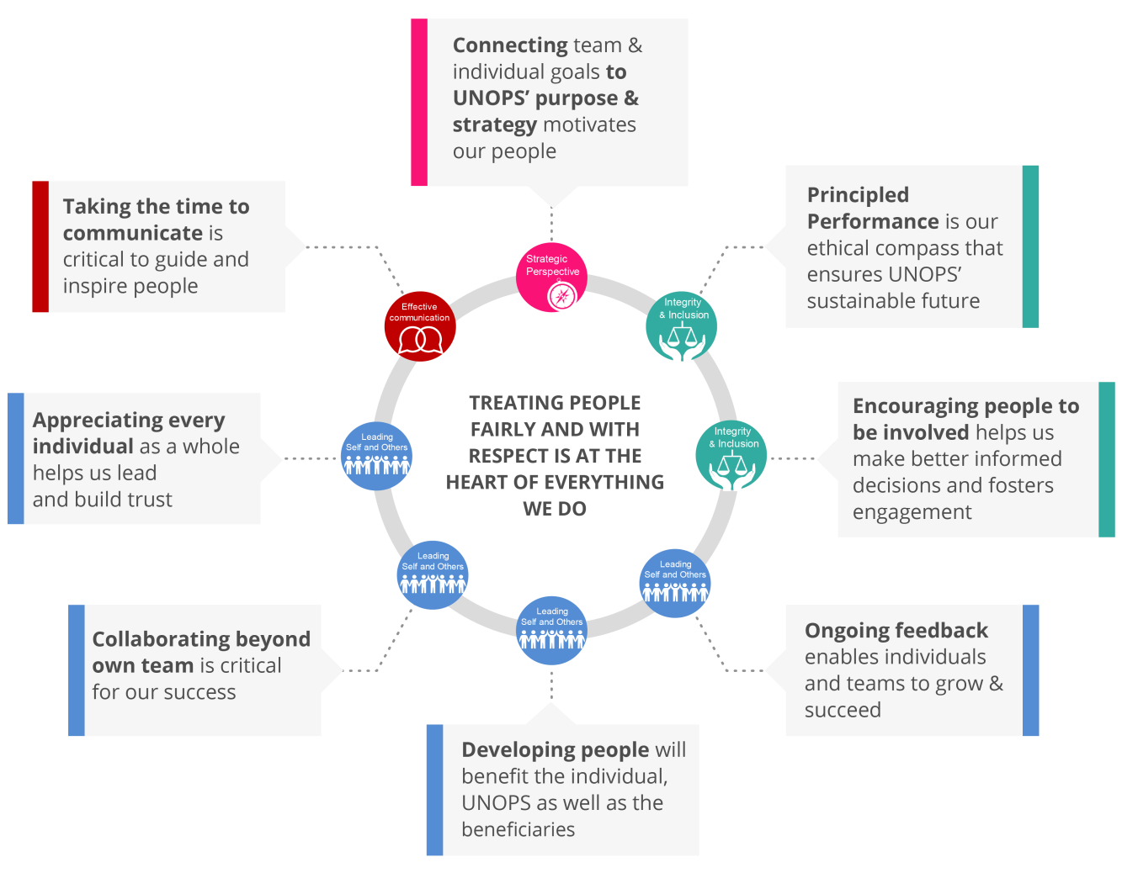
The Leadership Mindset at UNOPS
Notes:
To develop this we again interviewed many stakeholders in the organisation to really understand what is expected of a Team Leader in UNOPS. We also looked at the results of our engagement survey.
On this slide you can see that we have highlighted some competencies which are of particular importance of team leads. Using the same icons again helps anchor it.
Explain the Leadership mindset
Again bringing the mindset to life is a challenge, we need to overcome.
The leadership mindset at UNOPS is as relevant to leaders as it is to those being led, in terms of both directing behaviours and setting expectations for behaviours. Hence UNOPS will roll out a global discussion fora in offices globally. The expectations will be to have meaningful discussion among the leaders and teams in offices.
Add on:
Reasons for such workshop:
To develop a shared understanding of what it means to be a people leader at UNOPS and the balances that leaders need to manage.
To establish a common approach to leadership at UNOPS by identifying effective and successful leadership behaviours, values and beliefs specific to the UNOPS context.
To enable leaders to embody and exhibit the leadership mindset, and communicate to UNOPS colleagues what they should expect of their leaders.
(Principled Performance: Reliable achievement of objectives, while addressing uncertainty and acting with integrity.)

Slide 8

Thank you.
Any Questions?

Slide 9
LEVELS
Level 1 & 2 | IICA-4, P5, NOE and above
Level 3 | IICA-3, IICA-2, LICA Specialist-11, LICA Specialist-10, P4, P3, NOD, NOC
Level 4 | IICA-1, LICA Specialist-9, LICA Specialist-8, LICA-7, LICA-6, P2, NOB, NOA, G7, G6
Level 5 | LICA-5, LICA-4, LICA-3, LICA-2, LICA-1, G5, G4, G3, G2, G1

